Slide 1


Drone Relay
Aerial Drone Platform with relays for scenarios of limitation and emergency
Mentors:
Prof. Susana Sargento
Prof. Miguel Luís
Margarida Silva
Nuno Ferreira
Group 8:
Guilherme Amaral Ribeiro Pereira
João Tiago Lacerda Rainho
José Luís Rodrigues Costa
Diogo Miguel Rocha Amaral

Slide 2
Context
Many research projects have been developed due to the importance of UAVs in Surveillance and monitoring tasks.
This project is going to be developed with the foundation of a mission planning project.

Slide 3

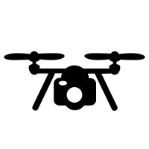




Goals
Measure network quality between the nodes
Relay drone adopts an optimal position to provide good network quality to the mission drones.This position is dynamically updated.
Dynamically adapt telemetry frequency, transmission ratio and video quality according to the current communication quality.

Slide 4
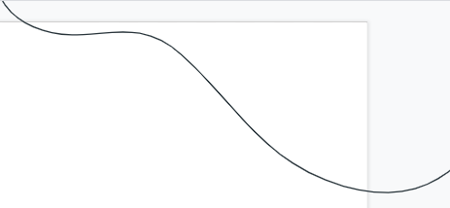

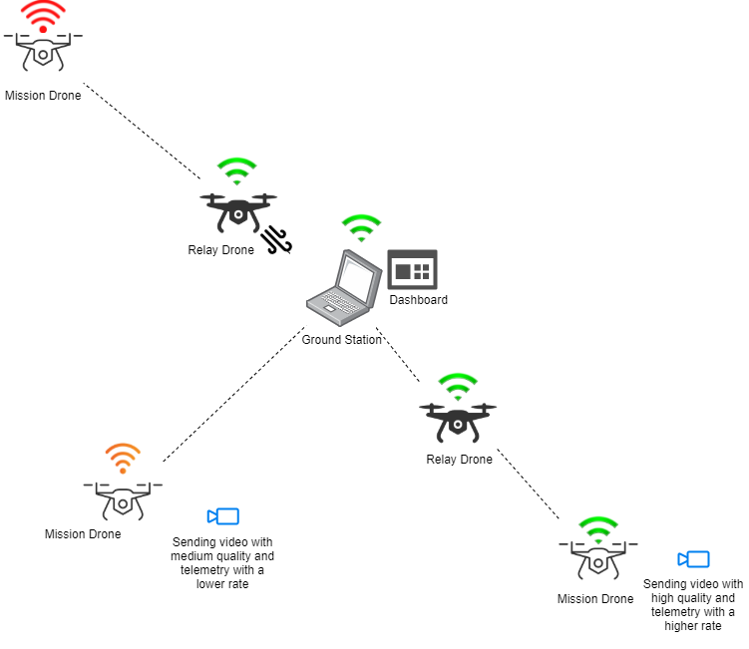

Overview
Video quality codec Module
Wireless Network Sensor
Mission Algorithm
Telemetry Module
Backend and Dashboard

Slide 5
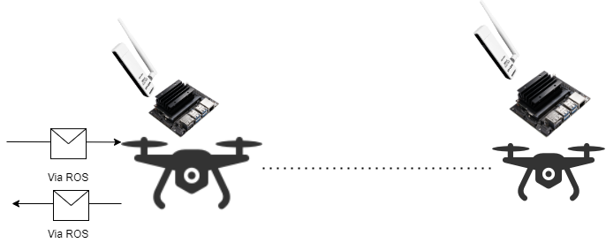
Wireless Network Sensor
This module provides network quality parameters between specific nodes in the ad-hoc network.
The Ground Station can make requests, via ROS, asking for the network quality between drones/Ground Station.
The network sensor that receives this request, using tools such as IW and the ping tool, will retrieve the values such as the RSSI(Received Signal Strength Indicator), the Sending/Receiving Bit rate, the latency, make an estimate value of the network quality and forward the information via ROS.
We also implemented metrics such as the interface current throughput using the sysstat tool and the number of collisions and errors using ifconfig, however they were not used on the field tests due time constraints.

Slide 6
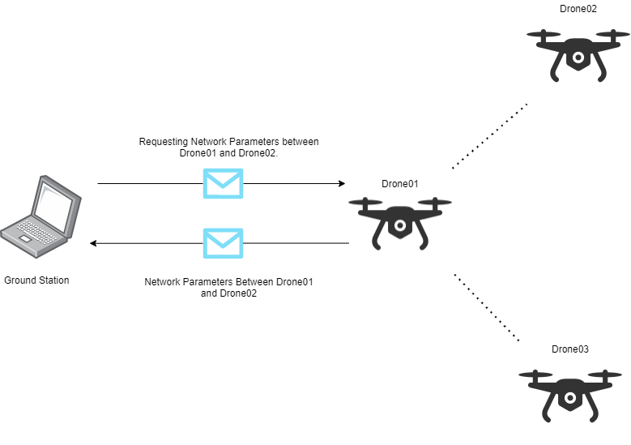
Wireless Network Sensor
Example of a message with the network parameters between drone01 and drone02:
{Station: “04:05:06:07:08:01”
IP: “10.1.1.6”
Latency: “0.80ms”
Signal: “70.0”
TxByte: “12056”
RxBit: “48 Mbit/s”
TxBit: “48 Mbit/s”
Connection: “drone02”
NetworkQuality: “HIGH”}
Requesting connection qualities
Example of a message with the network parameters between drone01 and drone03:
{Station: “04:05:06:07:08:00”
IP: “10.1.1.5”
Latency: “0.72ms”
Signal: “63.0”
TxByte: “12000”
RxBit: “54 Mbit/s”
TxBit: “54 Mbit/s”
Connection: “drone03”
NetworkQuality: “HIGH”}
Connections parameters

Slide 7
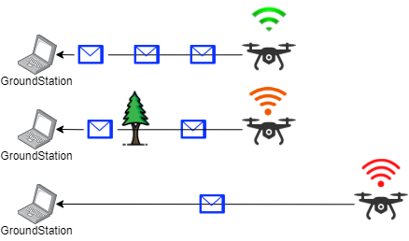
Telemetry module
High transmission ratio
Medium transmission ratio
Low transmission ratio

Slide 8
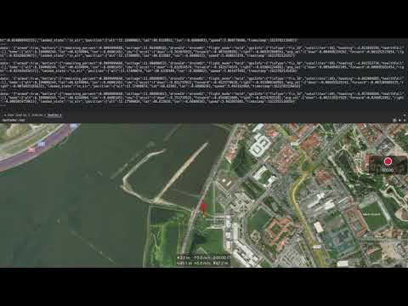
Video Demonstration

Slide 9
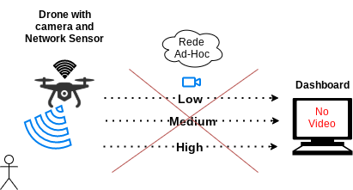
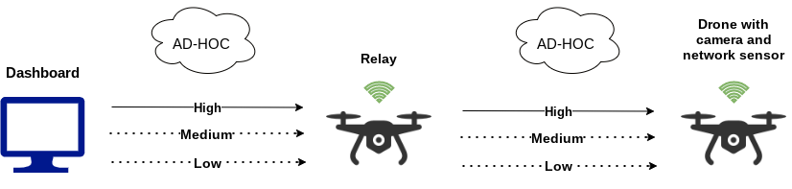
Video quality codec Module
This module is responsible for showing the video feed encoded from the drone automatically adapting quality with the network sensor.
Good Connection
No video

Slide 10
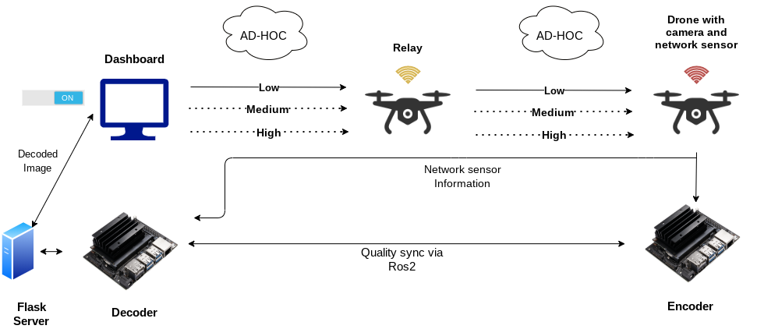
In-depth video quality Module
For the change and transmission of video to occur, the most important factors are:
Sync between the encoder and decoder
Video cutoff, as to not overload network
Change the quality with the network sensor, that provides a parameter with the best quality available according to the network state.

Slide 11
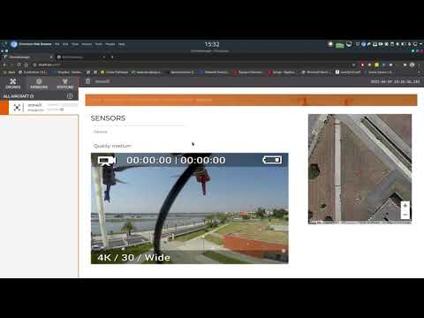
Video Demonstration

Slide 12
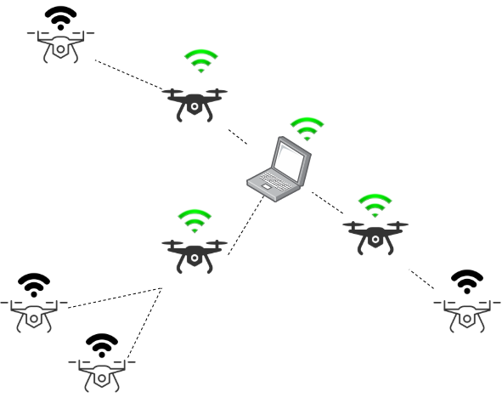
Mission Algorithm
Update drones position in order to provide the best possible network with the available drones.
Decomposed in 3 parts:
Network state: Graph representing the network.
Drone Relay Bridge: Connection between mission drone without connection to a connected entity.
Relay Link: connection between 1 drone and 1 entity.

Slide 13
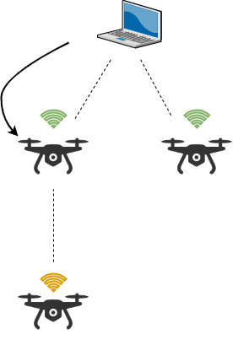
Mission Algorithm
The algorithm creates multiple trees, each tree starts with a connected entity (ground station or connected drone), then the tree grows with drones needing relay in order to maintain their connectivity.
Every time a drone is added to the tree, it is maintained until is no longer needed or is worth to switch that drone to another tree.

Slide 14
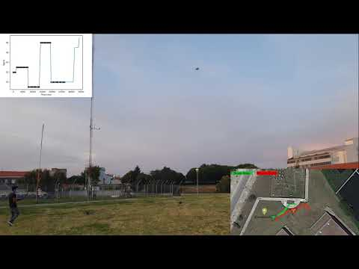
Video Demonstration

Slide 15
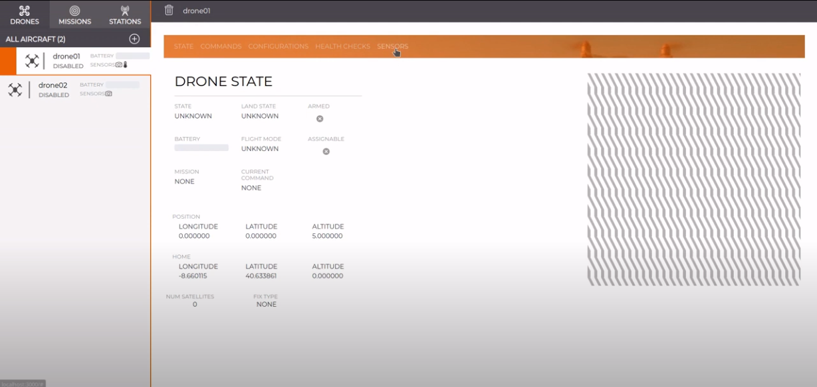
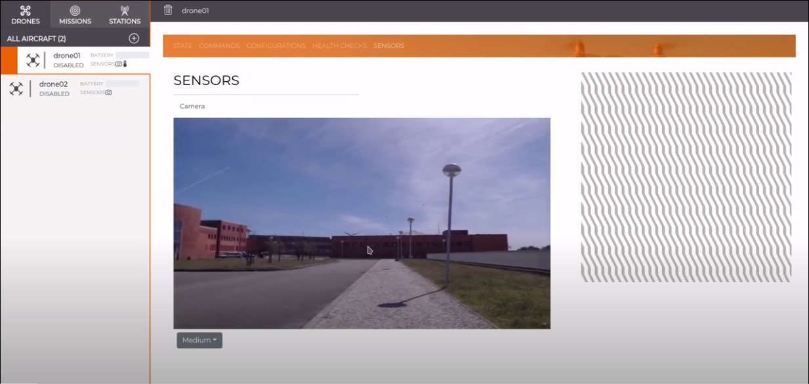
Backend and Dashboard

Slide 16
More Examples

Slide 17
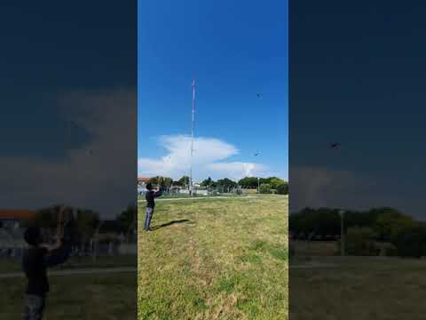
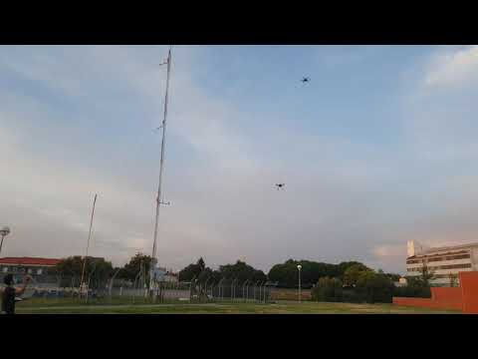
Videos

Slide 18
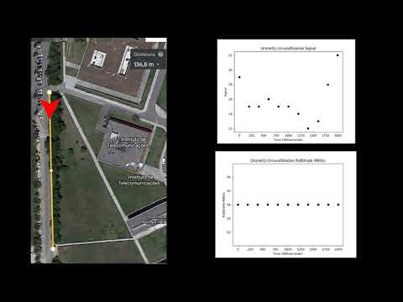
Milestone 3 - Video

Slide 19


Thanks!
Do you have any questions?
Group 8 - Drone Relay - PEI - 2020/2021

